Slide 1



Used Cars Analysis Project
Abdalla Gamal Mohamed

Slide 2


Objective:
Analyzed used car listings dataset
Cleaned, filtered, and preprocessed 370,000+ records.
Built an interactive web dashboard using Streamlit
Enabled filtering, visualization, and exploration
Project Overview

Slide 3
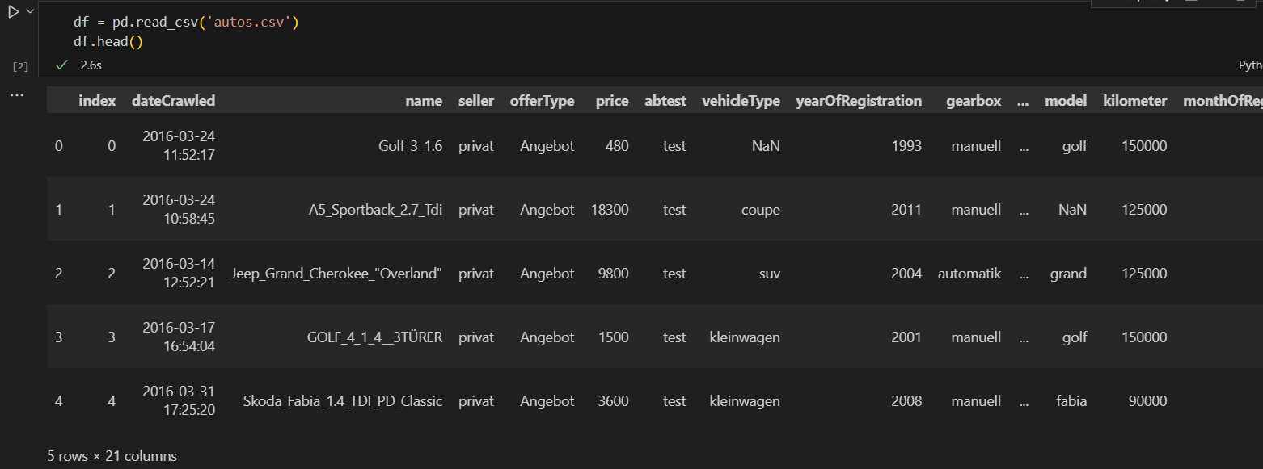
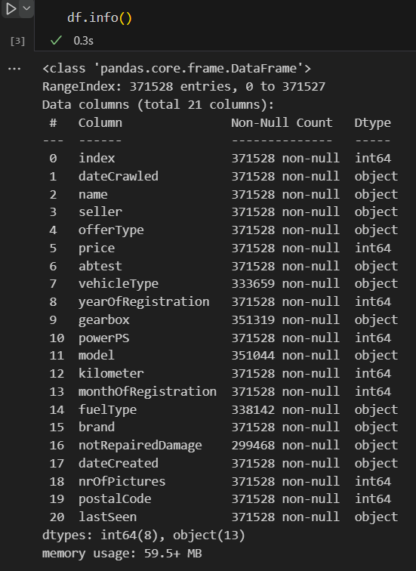
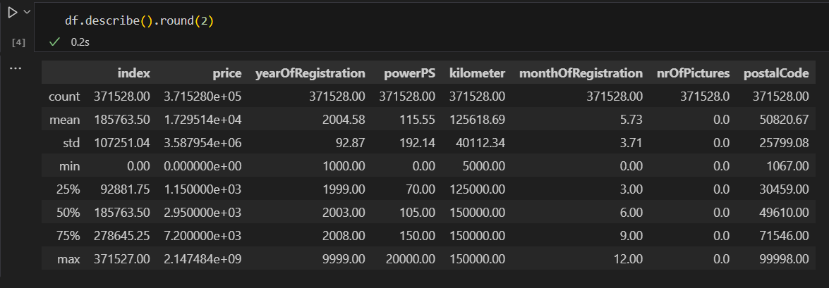
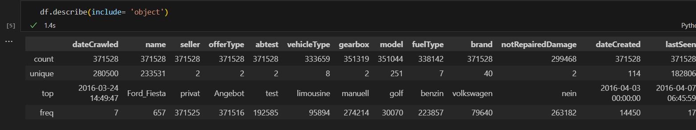
Data Discovery
Initial Understanding Before Cleaning
Dataset shape: 370,000+ rows, 20+ columns
Data types: mix of numeric, categorical, and date columns
Missing values detected in:
vehicleType, gearbox, fuelType, notRepairedDamage
German terms in columns (e.g., manuell, nein)
Inconsistent values:
monthOfRegistration = 0
price = 0 or > €150,000
yearOfRegistration < 1950 or > 2025
Duplicate rows found and removed

Slide 4
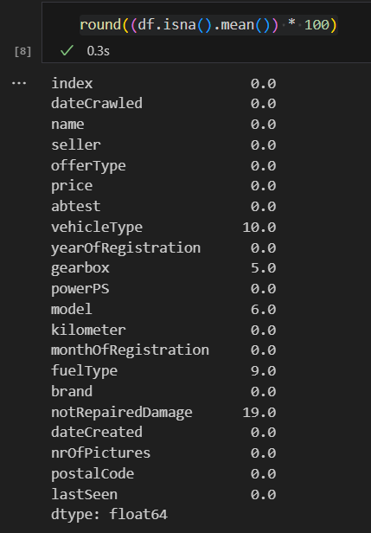
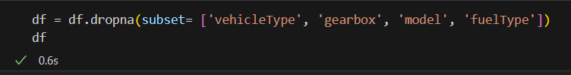
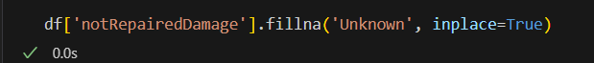
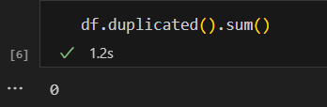
Data Cleaning
Removed duplicates and missing rows from key columns
Removed unnecessary columns
Converted German labels to English
Removed outliers (e.g., cars priced below €100 or over €150,000)
Engineered features:
car_age
car_age_group
price_range

Slide 5
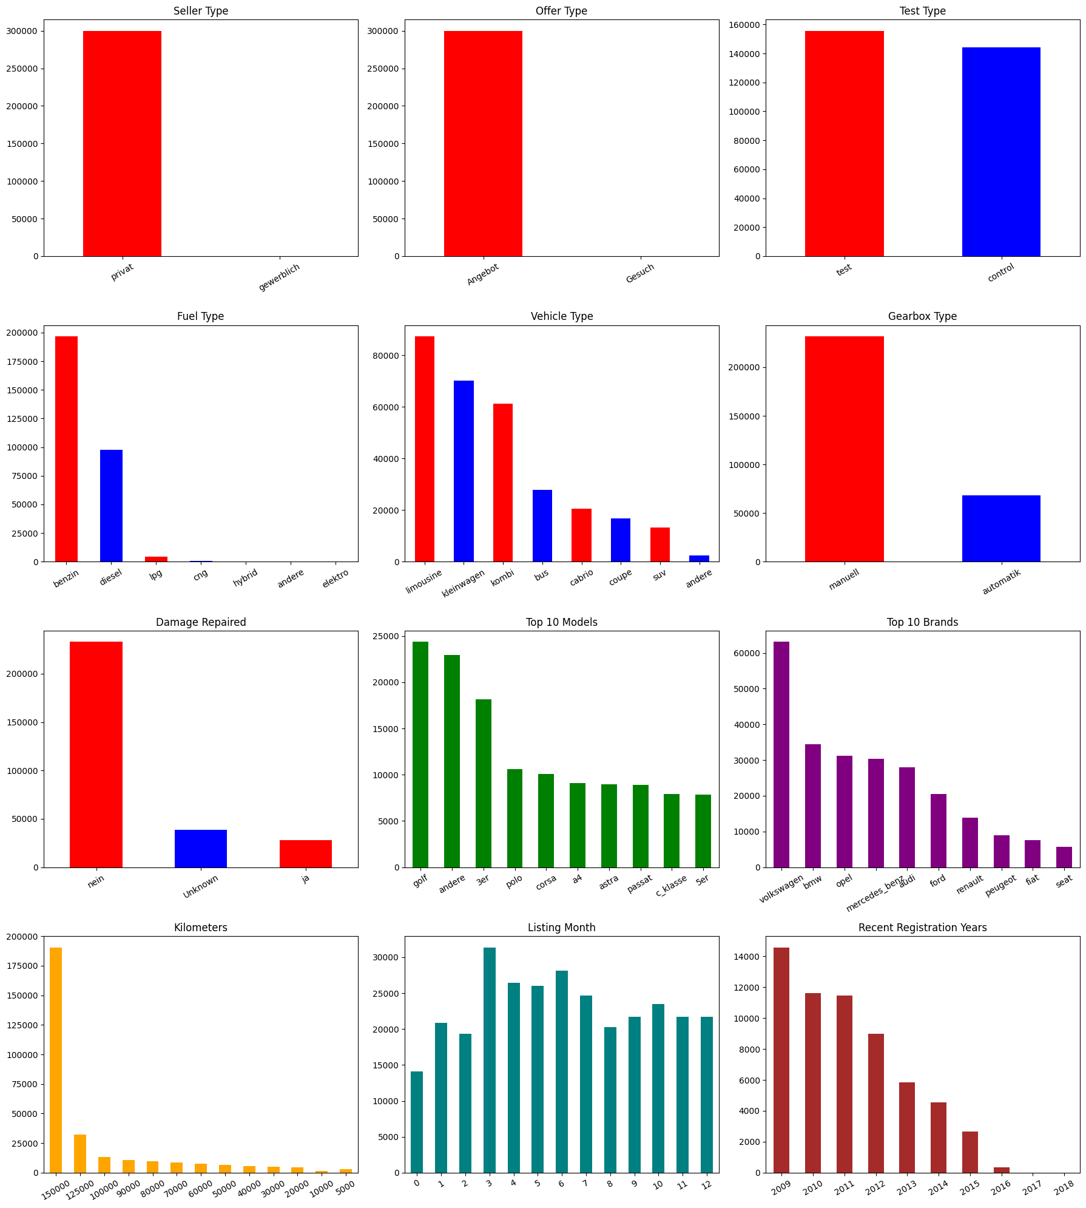
Visualizations (Exploratory Analysis)
✅ Bar Plots
Visualize categorical distributions:
Seller Type – privat vs. gewerblich
Offer Type – Angebot vs. Gesuch
Test Type – abtest variations (e.g., control vs. test)
Fuel Type – petrol (benzin), diesel, others
Vehicle Type – SUV, limousine, small car, etc.
Gearbox Type – manual vs. automatic
Damage Repaired – yes / no / unknown
Top 10 Models – most frequently listed car models
Top 10 Brands – most common car brands
Registration Months – seasonality patterns
Registration Years (last 10) – newer car trends

Slide 6
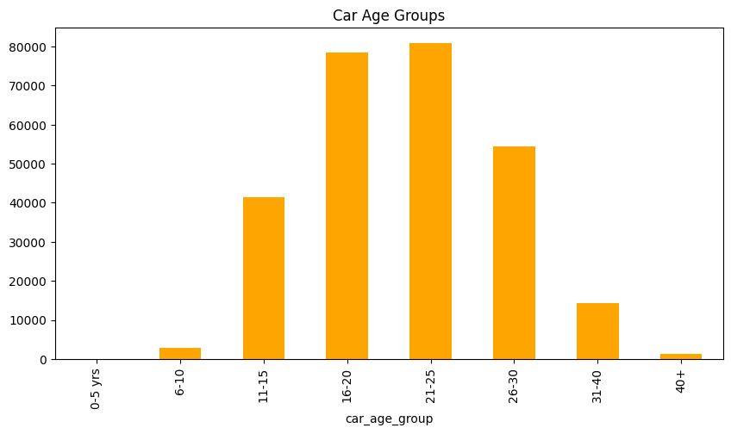
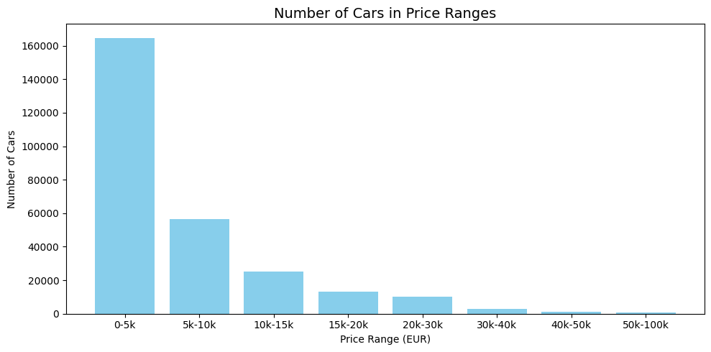
Exploratory Analysis
Graphs to the new Feautres

Slide 7
Encoding & Scaling
Why Encoding & Scaling?
Machine learning models require all inputs to be numerical and within similar ranges to perform optimally.
Label Encoding (Categorical Features)
Converted categorical text into integers using LabelEncoder
Applied to:
vehicleType, gearbox, model, brand
fuelType, notRepairedDamage, car_age_group
abtest, price_range
✅ Result: Categorical columns transformed into model-friendly numeric format
Standard Scaling (Numerical Features)
Used StandardScaler to normalize numeric features
Applied to:
price, powerPS, kilometer, car_age
Transformed to zero mean and unit variance
✅ Result: Ensured that no single feature dominates due to its scale

Slide 8
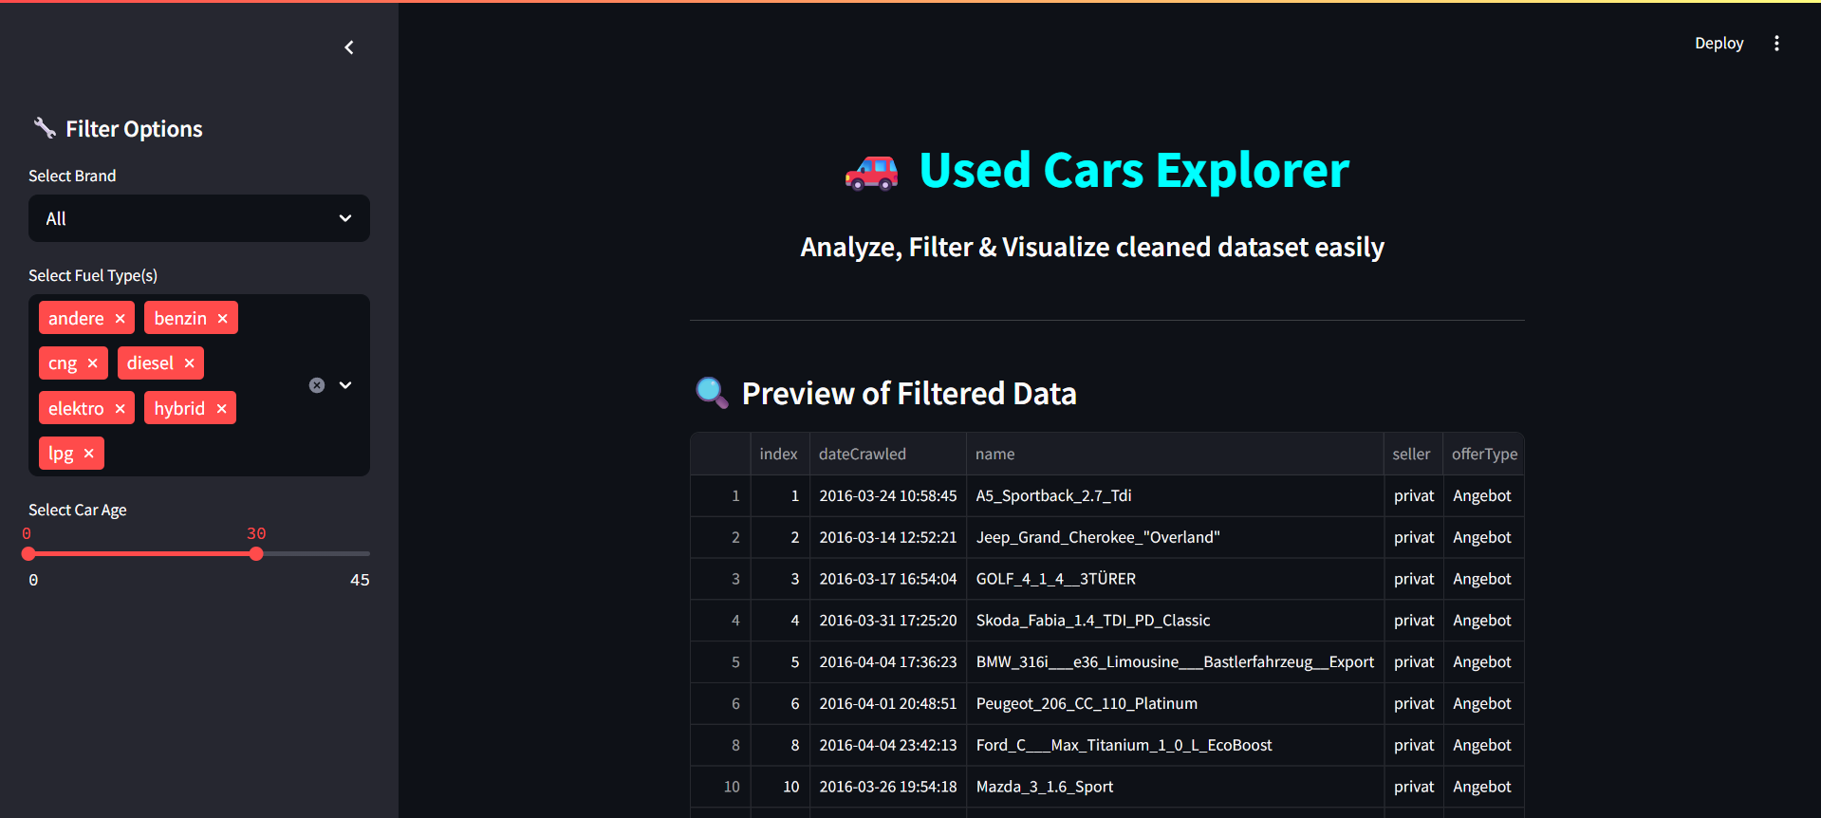
Streamlit Dashboard Features
Filters:
Brand.
Fuel Type(s).
Car Age Range.
Charts:
Price histogram.
Boxplots by vehicle type.
Price vs. Age scatter.
Model frequency and fuel share.
Stats Table & KPIs

Slide 9

Conclusion
Successfully cleaned and explored a real-world used cars dataset
Uncovered key insights through visual analysis (price trends, fuel types, car age impact)
Built an interactive Streamlit dashboard with filters and dynamic plots
Prepared the data for future machine learning tasks (price prediction, classification)

Slide 10




Thank you!
Abdalla Gamal Mohamed

